Slide 1
Chapter 10 Bivariate Relationships

Slide 2
Introduction
Bivariate Analysis
Statistical method to detect and describe relationship between two variables.
Crosstabulation (Bivariate Tables)
Table for highlighting the relationship between two variables, not “statistically demonstrating”
For nominal or ordinal variables

Slide 3
Example: Understanding Variables
If we hypothesize that health care access varies by a person’s racial identification…
What is the independent variable (the “cause” or “reason”)?
What is the dependent variable (the outcome or one you’re trying to explain)?

Slide 4
Bivariate Table
A table that displays the distribution of one variable across the categories of another variable

Slide 5
Constructing a Bivariate Table
Column variable
A variable whose categories are the columns of a bivariate table
Row variable
A variable whose categories are the rows of a bivariate table

Slide 6
Constructing a Bivariate Table
Cell
The intersection of a row and a column in a bivariate table
Marginals
The row and column totals in a bivariate table

Slide 7
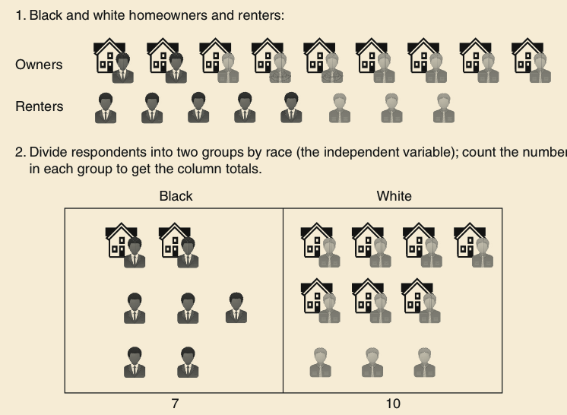
Constructing a Bivariate Table

Slide 8
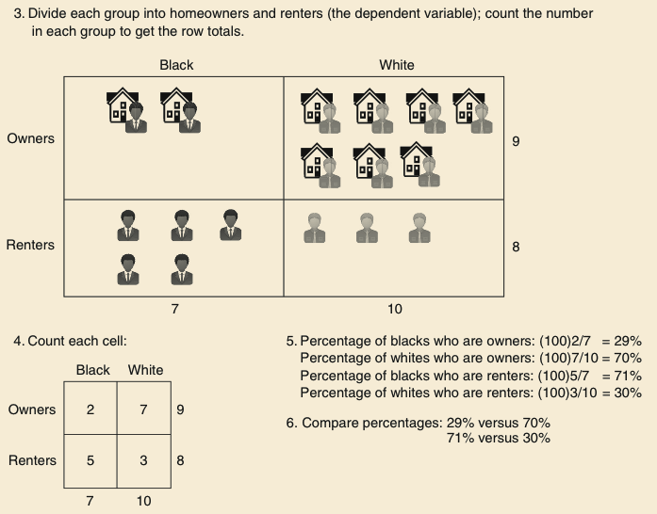
Constructing a Bivariate Table

Slide 9
Percentages
Can be computed in different ways:
Column percentages
Column totals as base
Row percentages
Row totals as base

Slide 10
Percentage a Bivariate Table

Slide 11
Dealing with Ambiguous Relationships
Think about which of the variables (concepts)…
precedes the other (independent)
is more changeable (dependent)

Slide 12
Properties of a Bivariate Relationship
Does there appear to be a relationship?
How strong is the relationship?
What is the direction of the relationship?

Slide 13
Existence of a Relationship
Hypothesis:
Women who experience more traumas are more likely to be pro-choice
Variables:
Number of traumas (independent)
Support for abortion (dependent)

Slide 14
The Strength of a Relationship
Examine percentage difference across categories of the independent variable
The larger the percentage difference across categories, the more likely a stronger association

Slide 15
Direction of the Relationship
Positive relationship
A bivariate relationship between two variables in which the variables vary in the same direction
As one increases, the other increases
As one decreases, the other decreases
Negative relationship
A bivariate relationship between two variables in which the variables vary in opposite directions
As one increases, the other decreases

Slide 16
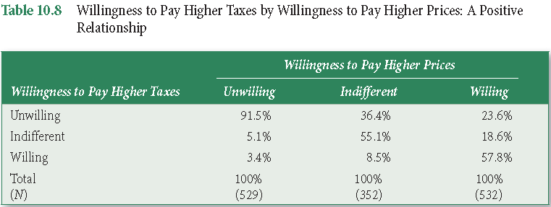
A Positive Relationship

Slide 17
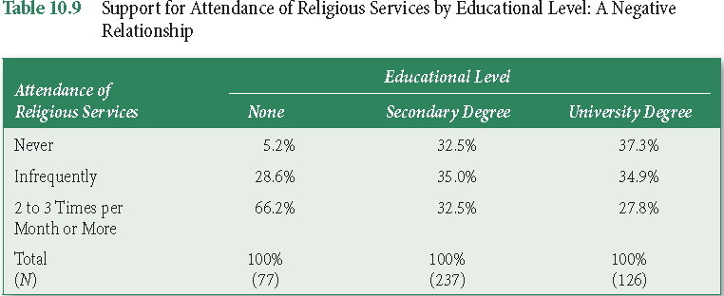
A Negative Relationship

Slide 18
Better Understanding the Relationship
Introduce control variables
Additional variables that could influence either or both of the variables in a bivariate relationship
Which can influence the overall relationship between the two variables

Slide 19
Control Variables
Three Goals
Allows us to test for non-spuriousness
Clarifies causal sequence of bivariate relationships by introducing variables that intervene between IV and DV
Specifies whether or not the relationship between two variables varies by levels of another variable

Slide 20
Testing for Nonspuriousness
Spurious Relationship
A relationship in which both the IV and DV are influenced by another variable… such that, its inclusion leads to little or no causal link between the IV and the DV

Slide 21
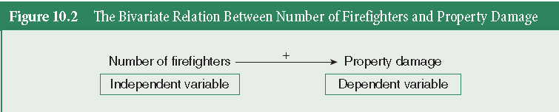
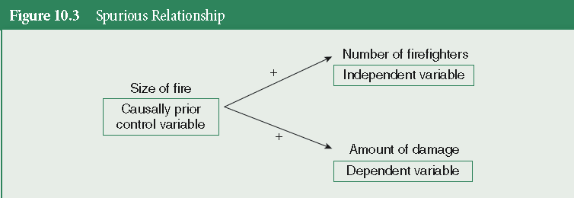
Spurious Relationship

Slide 22
Intervening Relationship (Mediation)
Intervening (Mediating) Variable
A control variable (mediator) that follows an independent variable but precedes the dependent variable in a causal sequence
Intervening (Mediating) Relationship
A relationship in which the control variable (mediator) intervenes between the independent and dependent variables

Slide 23
Conditional Relationship (Moderator)
A relationship in which the independent variable’s control variable’s effect on the dependent variable is conditional on its interaction with a control variable (moderator)
The relationship between the independent and dependent variables varies with different values of the control variable
There is a statistical interaction between the control variable and the independent variable

Slide 24
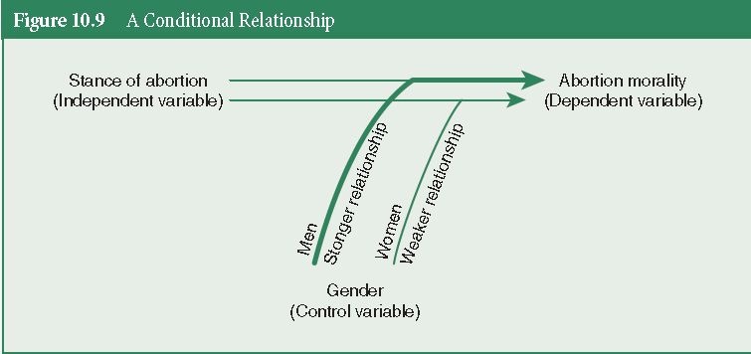
A Conditional Relationship

Slide 25
Key Terms
Bivariate analysis
Bivariate table
Cell
Column variable
Conditional relationship
Control variable
Cross-tabulation
Direct causal relationship
Elaboration
Intervening relationship
Intervening variable
Marginals

Slide 26
Key Terms
Negative relationship
Partial relationship
Partial tables
Positive relationship
Row variable
Spurious relationship

